Slide 1
CpE 403 Final Project
Abenezer Namaga, Estellar Raganit

Slide 2
Goal
Main Goal
We will be interfacing a sensor to the sensor node and transmit the obtained data using the TI-15.4 stack RF to the co processor. The BBB collects the data which will display the data and is interfaced with a co-processor which is the CC1350.
Objectives
We were able to achieve our goals by interfacing the temperature sensor, which was included in the sensor program that collected the data in Celsius which sends the data to the co-processor which would receive data and send it to the BBB.

Slide 3
Outcome - Accomplishments
Outcome – result of your project?
The outcome of our project was successful. We were able to interface a temperature sensor to the sensor board that had code written for it already. The sensor board then sent that data to the co-processor which would process the data and send it to the BBB. The BBB would then upload the data to an online source to show the temperature. We attempted to try and use Humidity and Lux since those were in the code as well but failed when we didn’t have the sensors to use.
This project is endless with the capabilities and in use in that, it can be used for a short term thing to a long term thing. Transmitting data is very universal with this project. This can be used for home projects to projects with companies.

Slide 4
Components Used in Design
We used the BBB and two CC1350 boards. The temperature sensor built in the 1350 board was also used in our project.
TI-15.4 collector app was used as our online visualization tool.
The data we collected was visualized through the web browser.

Slide 5
Tools used in Design
CCS for programming CC1350: http://processors.wiki.ti.com/index.php/Download_CCS
Uniflash: http://www.ti.com/tool/uniflash
Linux am335x-evm: http://software-dl.ti.com/processor-sdk-linux/esd/AM335X/latest/index_FDS.html

Slide 6
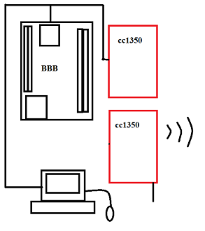
Schematics
Power

Slide 7
Pre-requisites used in Design
Prerequisites
Virtual box Linux 14.04, 2 x CC1350 Launch Pads, BBB, Host PC
Commands to install prerequisites
$ sudo apt-get instal … (or)
$ git clone .... (install from src)
ssh root@ip address
scp bbb_prebuilt.tar.gz root@<bbb-ip-address>:/home/root/ (copies file to PI
./run_demo.sh
tar -xzf bb_prebuilt.tar.gz

Slide 8
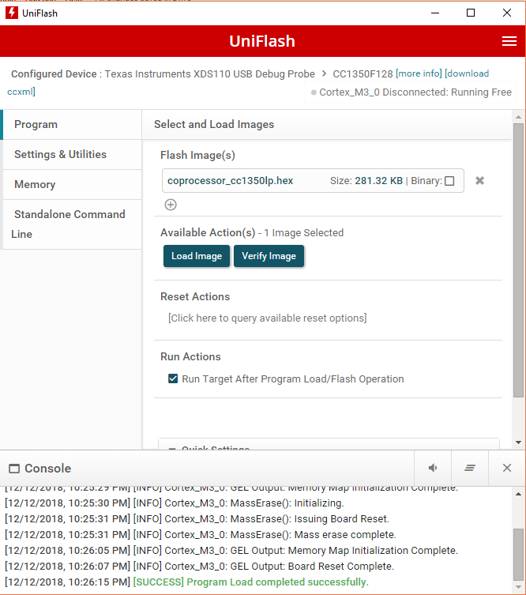
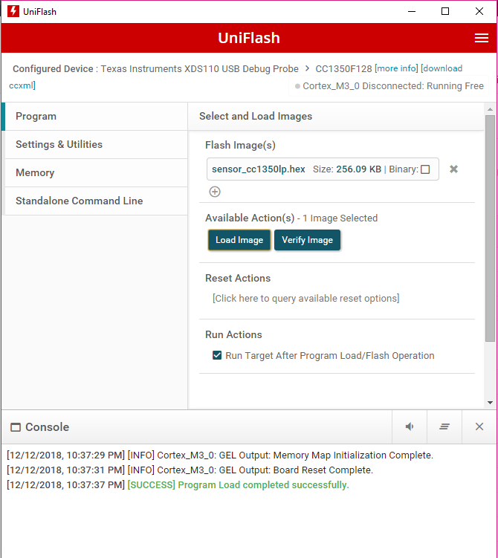
Coprocessor and Sensor
Flashing Coprocessor and Sensor

Slide 9
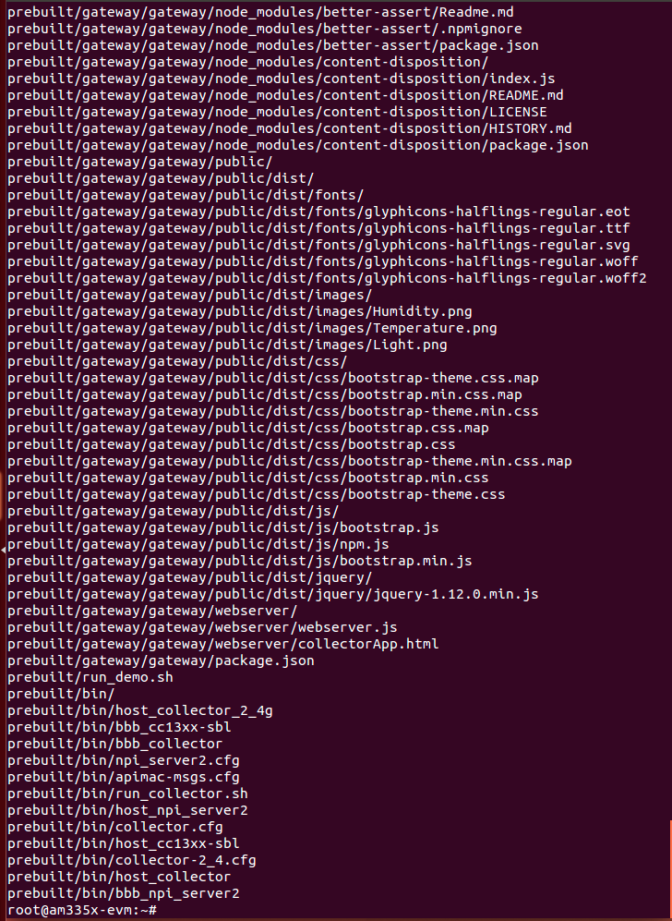
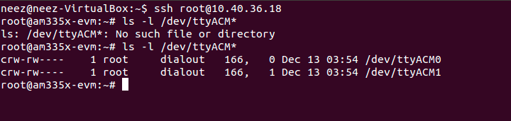
Implementation Details
Used Uniflash to load the hex files onto to our launchpads.
Burnt a linux am335x-evm image on an SD card using Etcher
Sent (“scp”) ziped prebuilt from linux on to to BBB and extracted in root

Slide 10
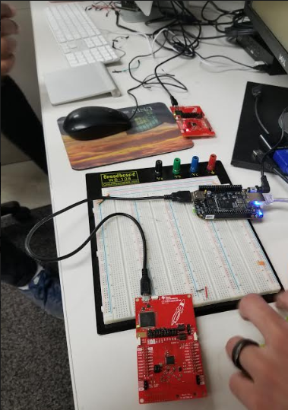
Actual project set-up
CC1350 *2
BBB

Slide 11
Demo
Video: https://youtu.be/x1k0bNMw_uU

Slide 12
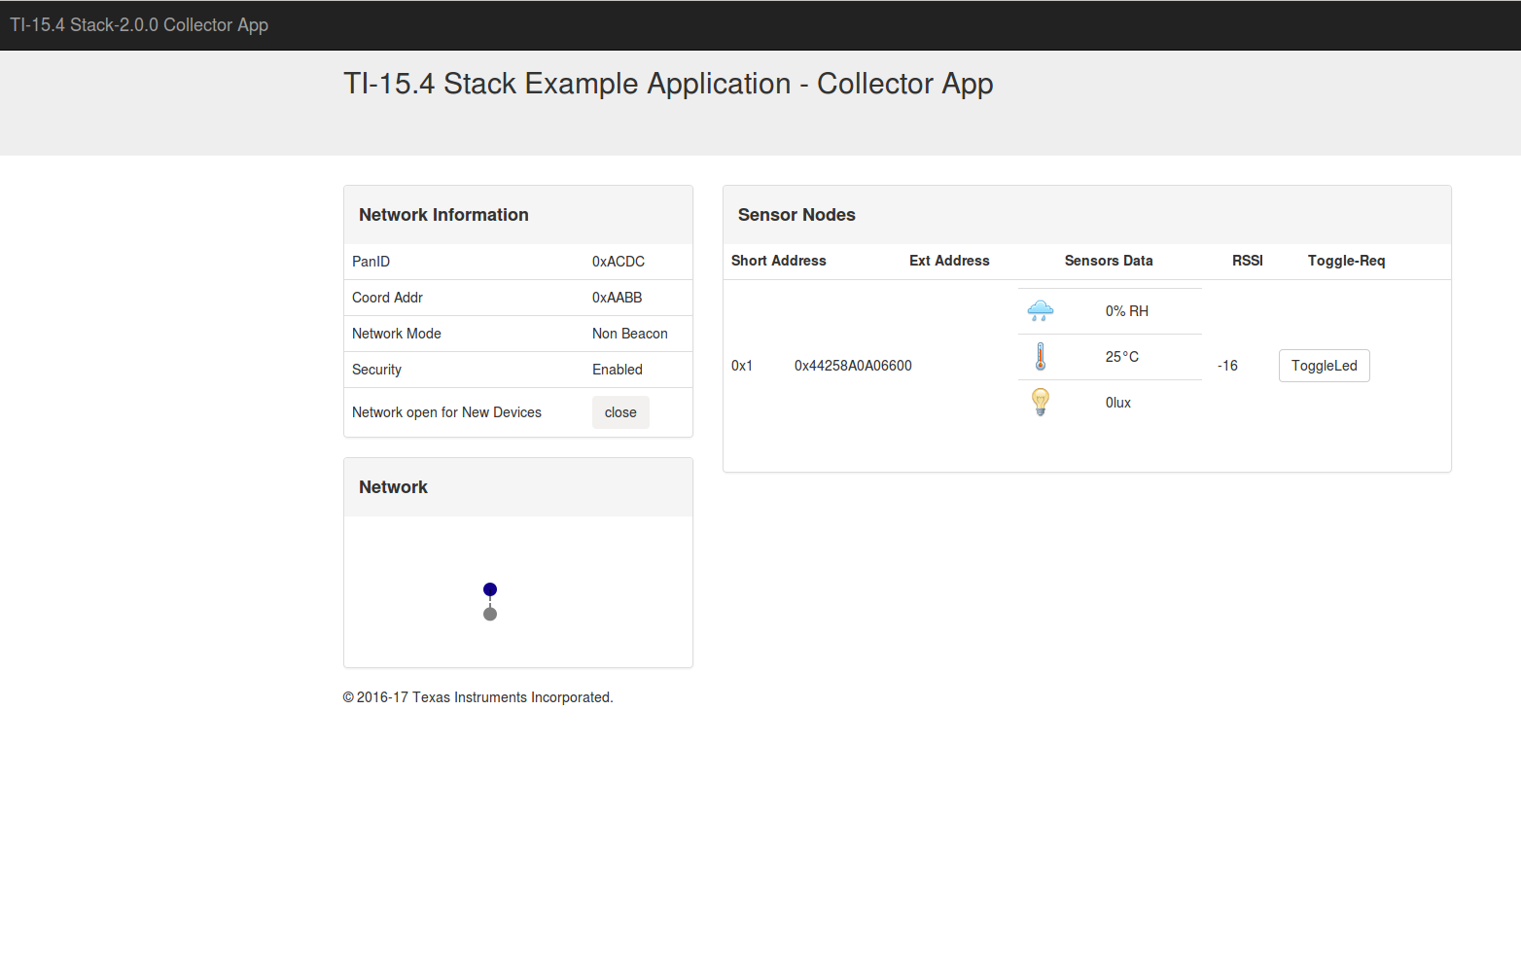
Results and Conclusions
Picture below shows the demonstration of the stack example. Run “run_demo.sh” in terminal from the prebuilt bolder. Opened up the generated link.

Slide 13
Reference
Stack overflow
Texas Instrument website
TI Q&A
CCS resources
CC1350 assignments

